Slide 1

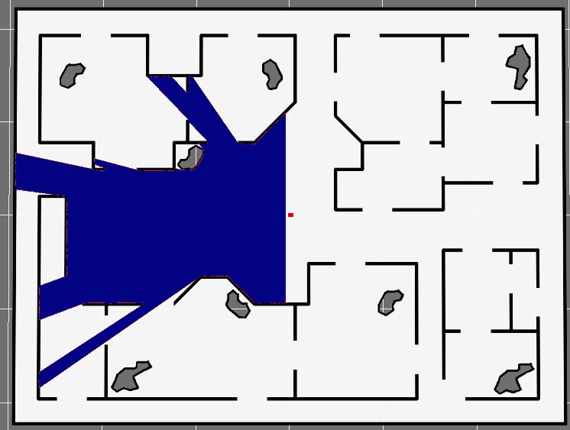
Laser rangefinder navigation
Project presentation:
27/01/2023
Students:
Bontempelli Elia
Castioni Edoardo 232250
Dalle Vedove Matteo
Rizzardi Alessandro
Fig.1: GridmapNavSimul

Slide 2
Outlines
Project goals
Slam algorithm
EKF
Model

Slide 3
Project goals
Localization of the robot
Estimation of the robot state (x,y,ϑ)
Main goals
Comparison
Additional goal
Map the environment
Estimate of ϑ using the SVD

Slide 4
SLAM: simultaneous localization and mapping
Bayesian filter Extended kalman filter
Proptioceptive sensors Odometry measurements on the robot’s state
Exterioceptive sensors LIDAR measurements
Drift (low frequency noise)
Very fast and accurate sensor

Slide 5
EKF: Extended Kalman filter
One of the most used statistical iterative sensor fusion tool.
Input must be: gaussian, white and unbiased.
Model of the suystem must be linear linearization
The model for a general non linear system is:
x(k+1) = fk(x(k),u(k),η(k))
z(k) = hk(x(k),ε(k))
Predicion step: using the model
Initialization of the estimate
x_est(k+1) = fk( x_est(k), u(k), η(k))
P_est(k+1) = A(k) P_est(k) A(k)’ + G(k) Q(k) G(k)’
Update: using the measurements
S(k+1) = H(k+1) P_est(k+1) H(k+1)’ + R(k+1)
W(k+1) = P_est(k+1) H(k+1)’ / S(k+1)
x_est(k+1) = x_est(k+1) + W(k+1) (z(k+1) – hk( x_est(k+1) ) )
P_est(k+1) = (I – W(k+1)) H(k+1) P_est(k+1)
Measurements

Slide 6
Model of the system and Odometry

Slide 7
Lidar
The lidar (light detection and ranging) is a very precise measurement system.
The main parameters of the analyzed case are:
Field of view: 180 [°]
Range of measurament: 30 [m]
Resolution of angle: 0.5 [°]
FOTO LIDAR

Slide 8
Point cloud + features + collapsing

Slide 9
Workflow
Odometry
Prediction
Initialization
Observation LIDAR
Find correspondence with landmark
Features extraction
Check for a loop
Update
Update map:
new landmark
Remove too close features

Slide 10
Corrispondenza elissoidi + si muovono anche se non li vedo piu

Slide 11
Update corrispondenza

Slide 12
Map update: grid map method

Slide 13
Map update: chain of correspondences
A point is inserted in the map if it is seen at least n times with an high probability.
To do so a buffer of observed point is created.
Once an observation arrives, it is inserted in the buffer.
(x1,y1)
(x2,y2)
(x3,y3)
Observation vector
In this case 3 point are observed

Slide 14
Map update: chain of correspondences
Computing all possbile combination of distance, when I have at least two oservations
Matrix of distances in the buffer
Previous observation
New observation
P1 P2 P3 P4

Slide 15
Map update: chain of correspondences
Selecting the most probable correspondence
Matrix of distances in the buffer
Previous observation
New observation
P1 P2 P3 P4

Slide 16
Map update: chain of correspondences
Oldest observation
Matrix of distances in the buffer
Previous observation
New observation

Slide 17
Map update: chain of correspondences
Oldest observation
Matrix of distances in the buffer
Previous observation
New observation

Slide 18
Loop closure
The loop closure is a fundamental task of the slam because it allows to correct the estimated position that, inevitably, is affected by drift.
It consist in recognising in the new observations a pattern already saved in the map.

Slide 19
Risultati + video

